Slide 1

Computer Vision in Python Day 3, Part 1/4
Matthieu De Mari

Slide 2
About this lecture
What are generative models in deep learning?
What are Generative Adversarial Networks (GANs) and their uses?
What are the advanced techniques in GANs
What are deepfakes and ethical considerations when using generative models?
What are diffusion models?

Slide 3
What are generative models?
Definition (Computer Vision generative models):
In computer vision, generative models are models that can generate new visual data (typically new images) that are plausible and statistically similar to some training data.
In other words, we are talking about models that can generate realistic images out of thin air.
As such, generative models are the opposite of the computer vision models we have seen until now: the image is the output, and no longer the input of the AI model.

Slide 4
Typical uses of generative models
Many uses for computer vision generative models:
Image and video generation: generating an image based on a given description
Super-resolution and denoising: increasing the resolution of an image, or removing noise from an image
Style transfer: transforming a picture into a similar picture but different style.
Etc.

Slide 5
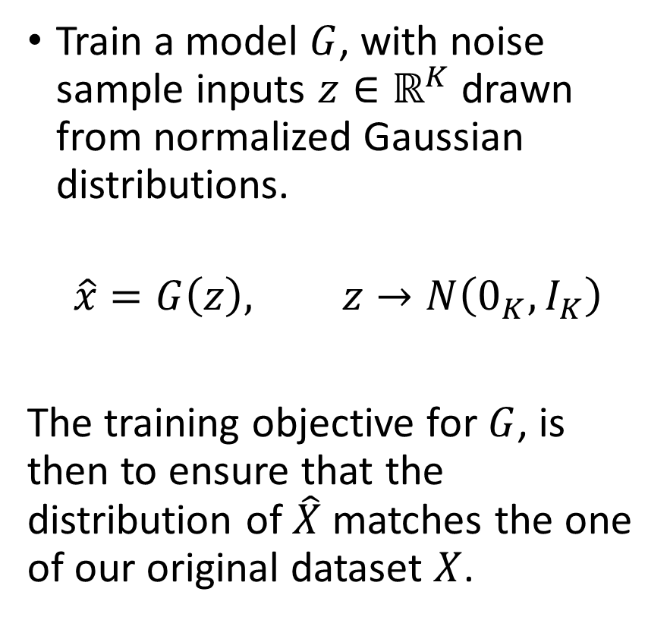
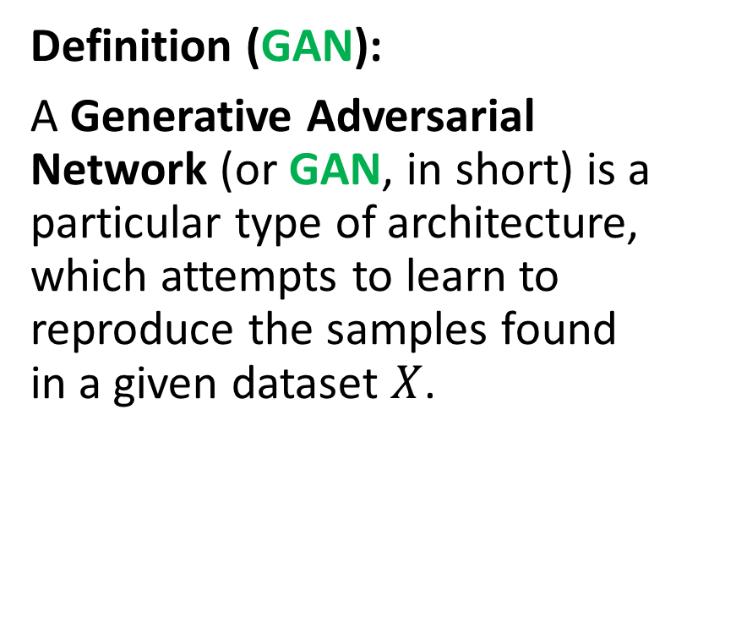
GAN definition
Definition (GAN):
A Generative Adversarial Network (or GAN, in short) is a particular type of architecture, which attempts to learn to reproduce the samples found in a given dataset $X$.
Train a model $G$, with noise sample inputs $z∈ℝ^{K}$ drawn from normalized Gaussian distributions.
$$\hat{x}=G\left(z\right), z→N\left(0_{K},I_{K}\right)$$
The training objective for $G$, is then to ensure that the distribution of $\hat{X}$ matches the one of our original dataset $X$.

Slide 6
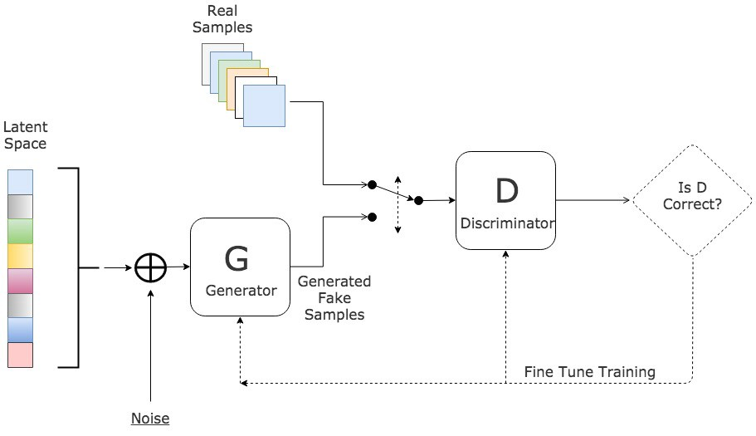
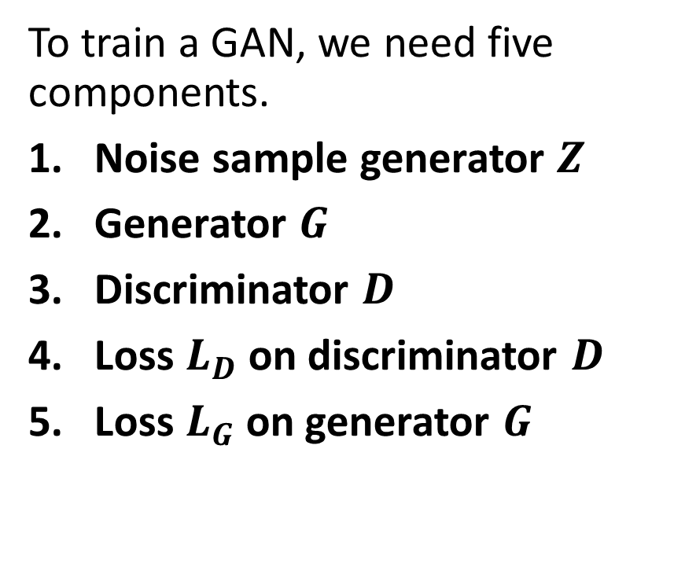
Vanilla GAN architecture
To train a GAN, we need five components.
Noise sample generator $Z$
Generator $G$
Discriminator $D$
Loss $L_{D}$on discriminator $D$
Loss $L_{G}$on generator $G$

Slide 7
Vanilla GAN architecture

Slide 8
Vanilla GAN architecture
To train a GAN, we need five components.
Noise sample generator $Z$
Generator $G$
Discriminator $D$
Loss $L_{D}$on discriminator $D$
Loss $L_{G}$on generator $G$

Slide 9
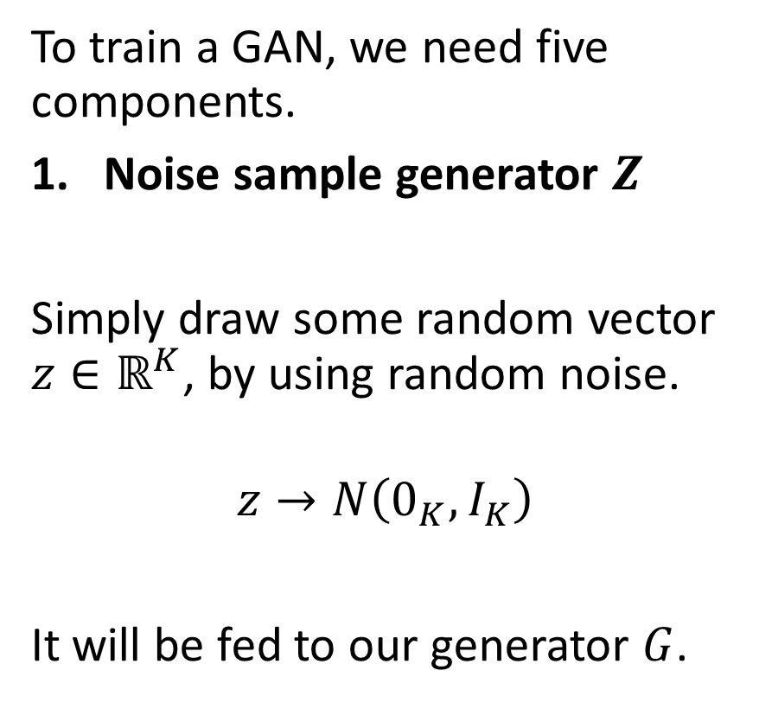
Vanilla GAN architecture
To train a GAN, we need five components.
Noise sample generator $Z$
Simply draw some random vector $z∈ℝ^{K}$, by using random noise.
$$z→N\left(0_{K},I_{K}\right)$$
It will be fed to our generator $G$.

Slide 10
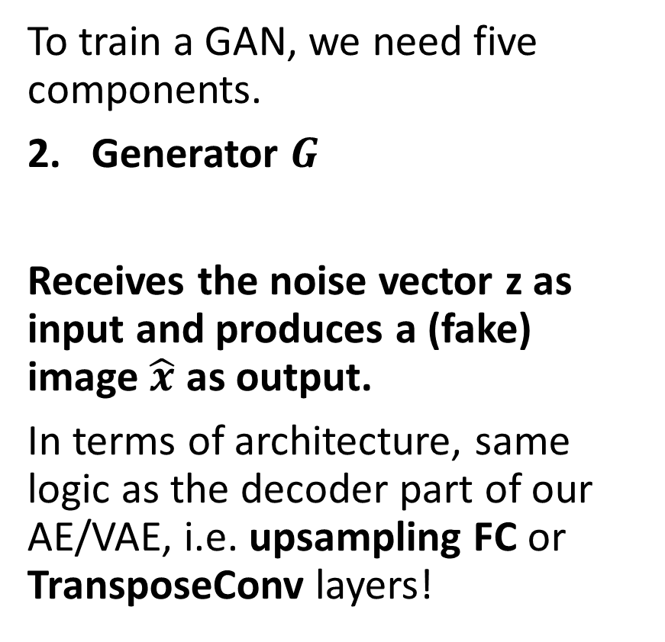
Vanilla GAN architecture
To train a GAN, we need five components.
Generator $G$
Receives the noise vector z as input and produces a (fake) image $\hat{x}$ as output.
In terms of architecture, same logic as the decoder part of our AE/VAE, i.e. upsampling FC or TransposeConv layers!

Slide 11
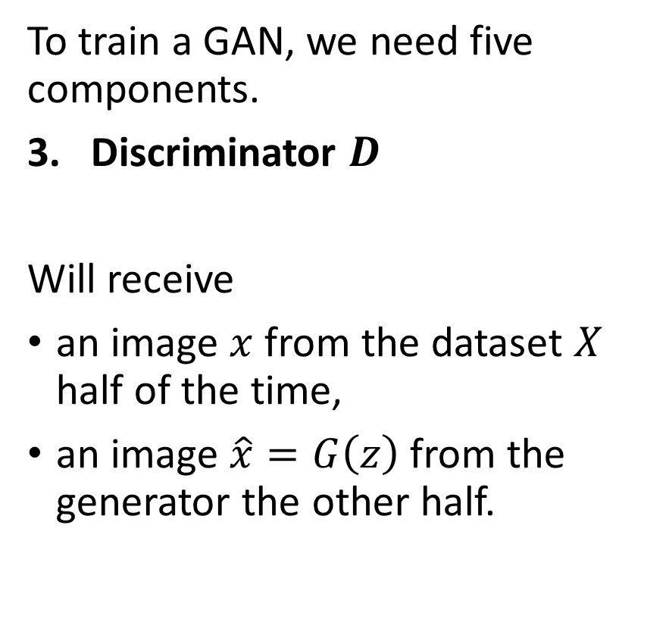
Vanilla GAN architecture
To train a GAN, we need five components.
Discriminator $D$
Will receive
an image $x$ from the dataset $X$ half of the time,
an image $\hat{x}=G\left(z\right)$ from the generator the other half.
Binary classification: needs to classify the image as fake (0) or real (1).

Slide 12
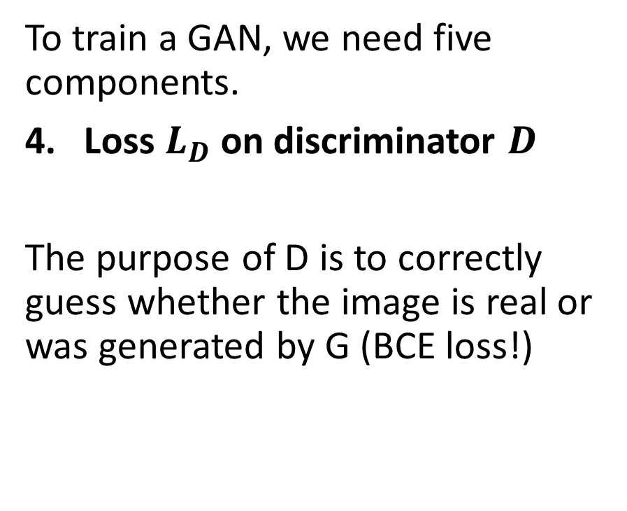
Vanilla GAN architecture
To train a GAN, we need five components.
Loss $L_{D}$on discriminator $D$
The purpose of D is to correctly guess whether the image is real or was generated by G (BCE loss!)
The first component checks if the discriminator is correctly classifying the real samples.
The second component checks if the discriminator correctly classifies the fake samples.
$$L_{D}=\frac{1}{N}\sum_{x_{i}∈minibatch(X_{N})}{−\log\left(D\left(x_{i}\right)\right)}+\frac{1}{N}\sum_{z_{i}∈minibatch(N)}{−\log\left(1−D\left(G\left(z_{i}\right)\right)\right)}$$

Slide 13
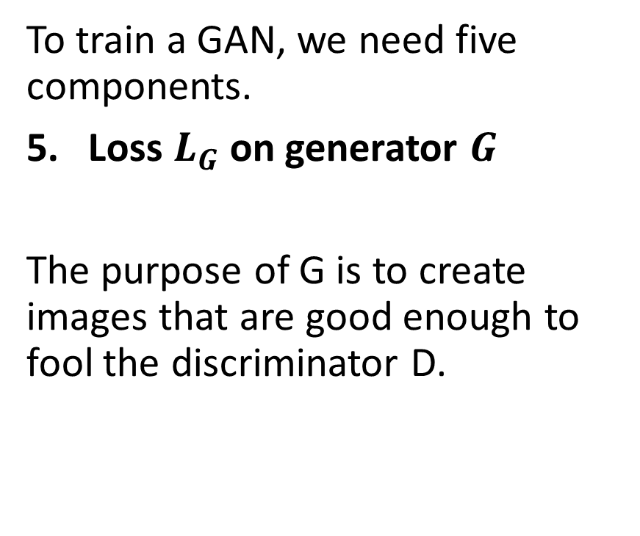
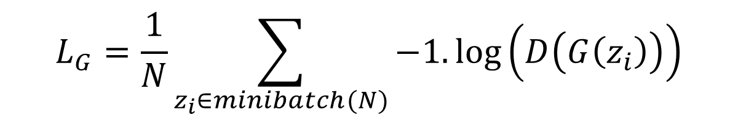
Vanilla GAN architecture
To train a GAN, we need five components.
Loss $L_{G}$on generator $G$
The purpose of G is to create images that are good enough to fool the discriminator D.
$$L_{G}=\frac{1}{N}\sum_{z_{i}∈minibatch(N)}{−1.\log\left(D\left(G\left(z_{i}\right)\right)\right)}$$

Slide 14
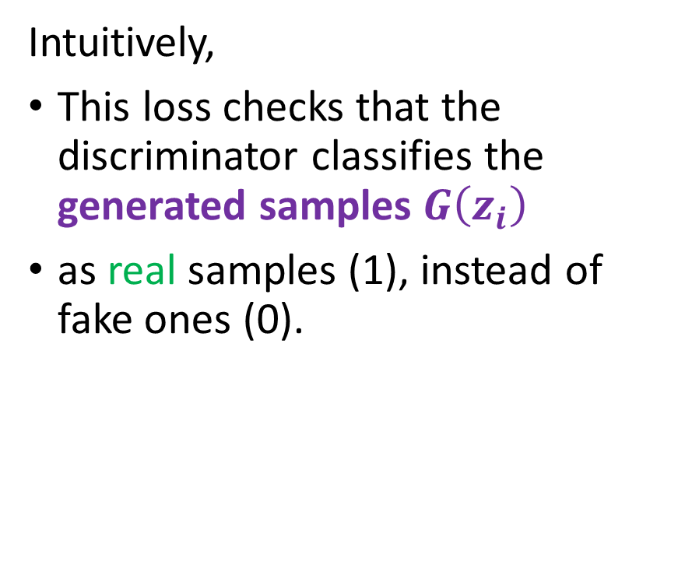
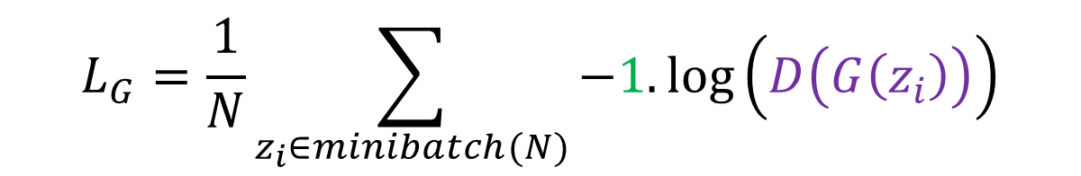
Vanilla GAN architecture
To train a GAN, we need five components.
Loss $L_{G}$on generator $G$
The purpose of G is to create images that are good enough to fool the discriminator D.
Intuitively,
This loss checks that the discriminator classifies the generated samples $G\left(z_{i}\right)$
as real samples (1), instead of fake ones (0).
$$L_{G}=\frac{1}{N}\sum_{z_{i}∈minibatch(N)}{−1.\log\left(D\left(G\left(z_{i}\right)\right)\right)}$$

Slide 15
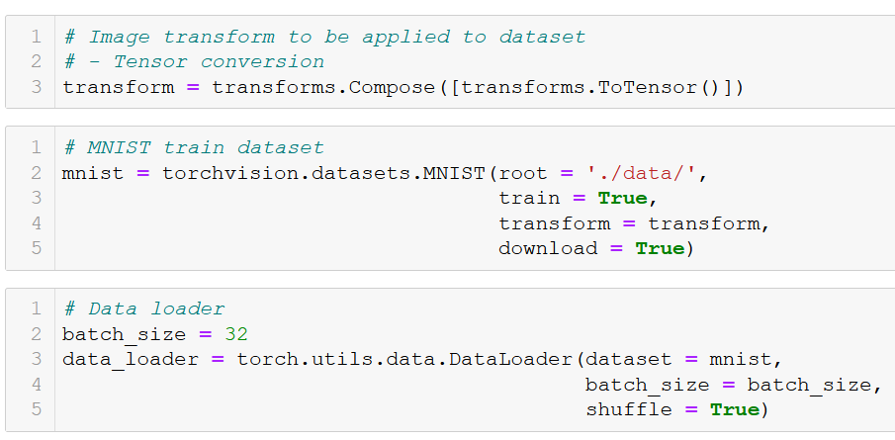
GAN implementation: dataset

Slide 16
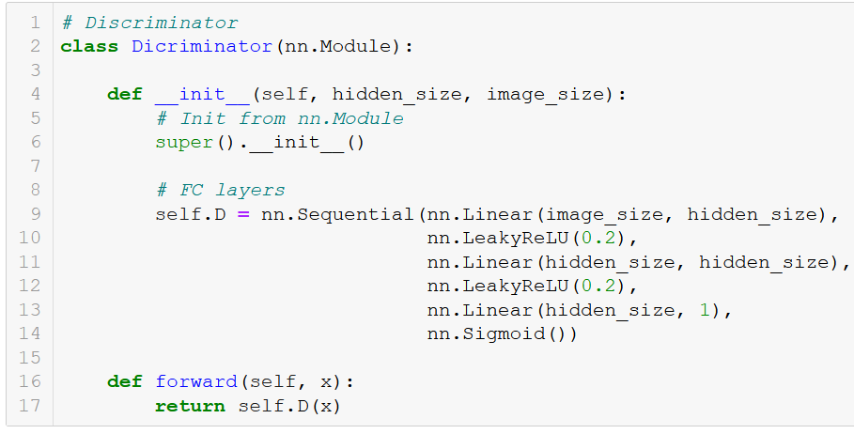
GAN implementation: discriminator
For simplicity, our discriminator, will be designed as stacked downsampling FC layers.
Freely decide on the hidden layer sizes.
(Later on, we might want to replace these layers with Conv2d, which are easier to train and better at working with images!)

Slide 17
GAN implementation: discriminator

Slide 18
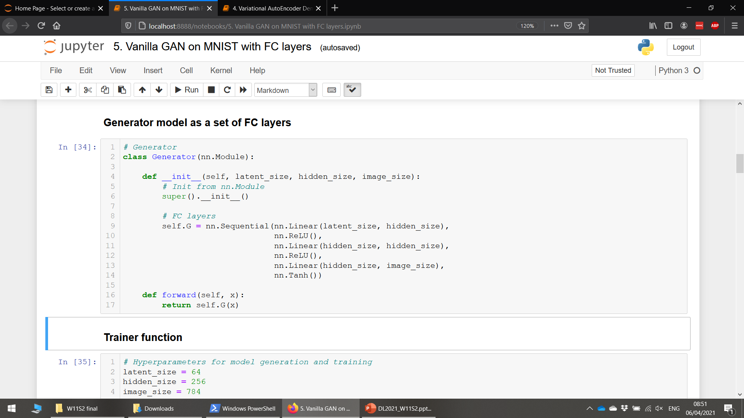
GAN implementation: generator
For simplicity, our generator will mirror the operations of our discriminator.
It will therefore consist of upsampling FC layers.

Slide 19
GAN implementation: generator

Slide 20
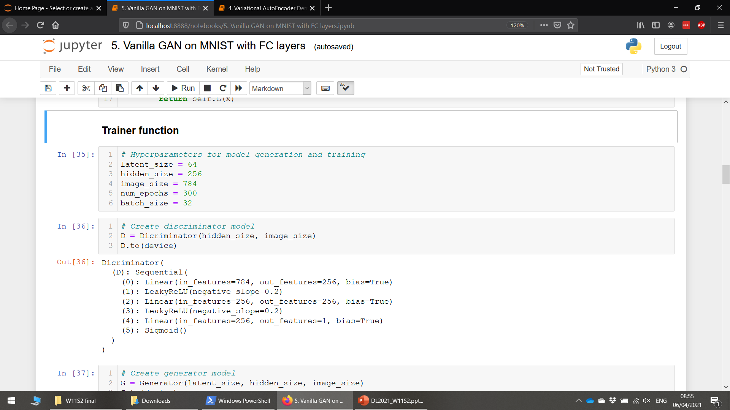
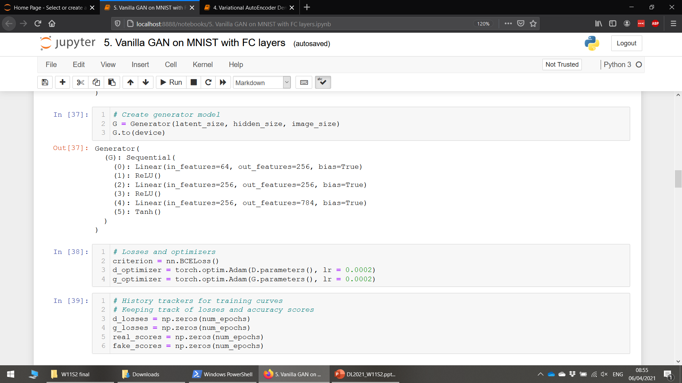
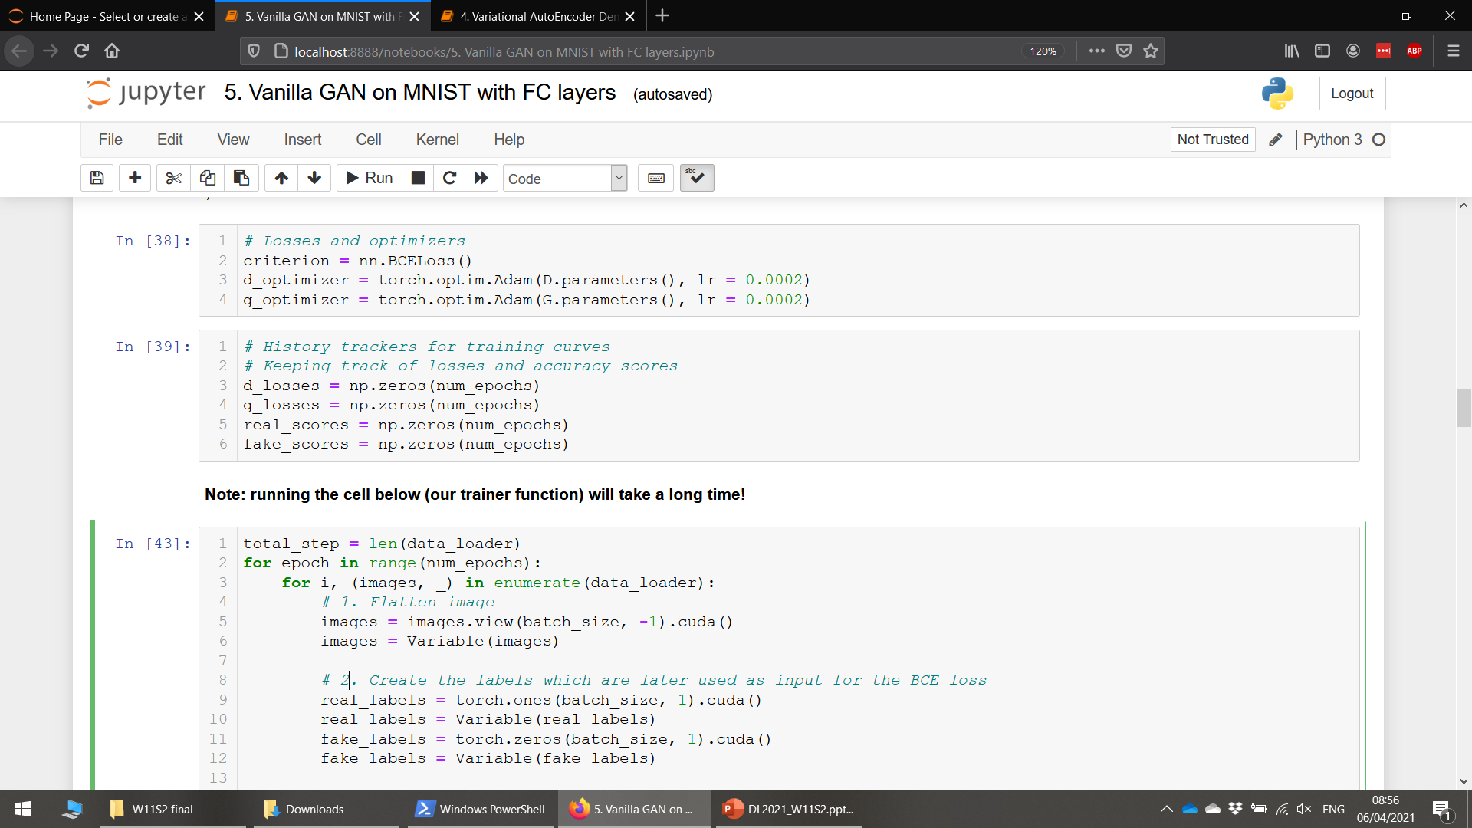
GAN implementation: trainer
Start by defining hyperparameters and models.
Latent size for noise samples fed to generator arbitrarily fixed.
Adam, with almost default parameters, arbitrarily chosen.
Losses on D and G for training curves later on.
Also, accuracy scores of D on real and fake samples for visualization after training.

Slide 21
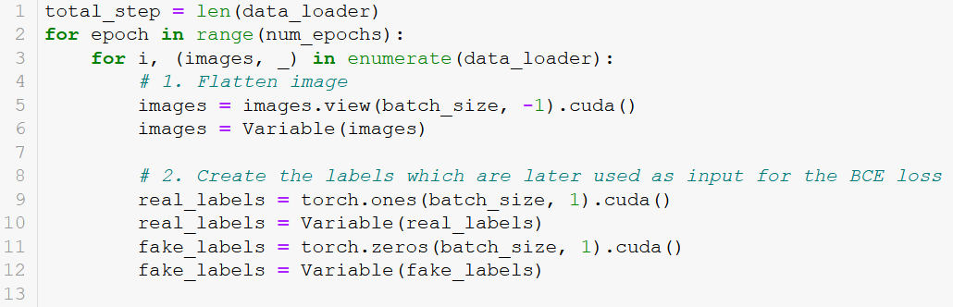
GAN implementation: trainer
Start by processing the samples
Generate N (mini-batch size) random noise samples, which will later be fed to generator. Make their labels 0.
Draw N (mini-batch size) samples from the dataset X, which will be fed to discriminator later on. Make their labels 1.
Flatten images (FC layers!)

Slide 22
GAN implementation: trainer

Slide 23
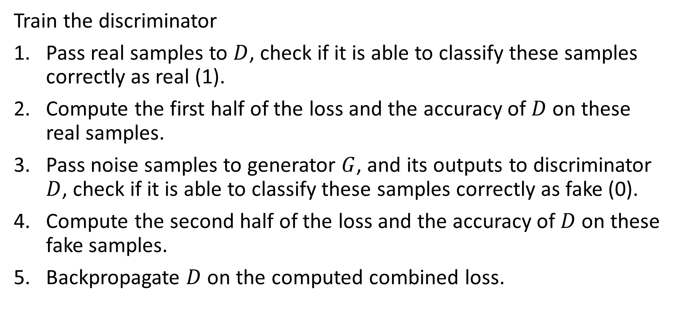
GAN implementation: trainer
Train the discriminator
Pass real samples to $D$, check if it is able to classify these samples correctly as real (1).
Compute the first half of the loss and the accuracy of $D$ on these real samples.
Pass noise samples to generator $G$, and its outputs to discriminator $D$, check if it is able to classify these samples correctly as fake (0).
Compute the second half of the loss and the accuracy of $D$ on these fake samples.
Backpropagate $D$ on the computed combined loss.

Slide 24
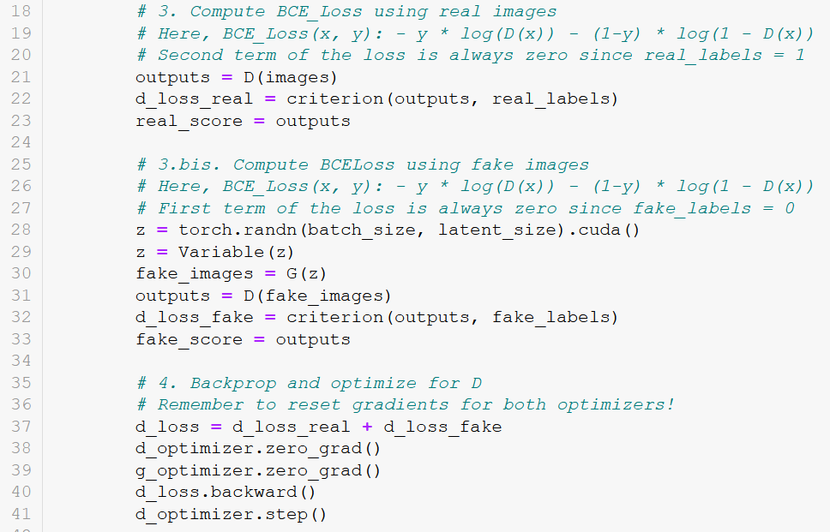
GAN implementation: trainer

Slide 25
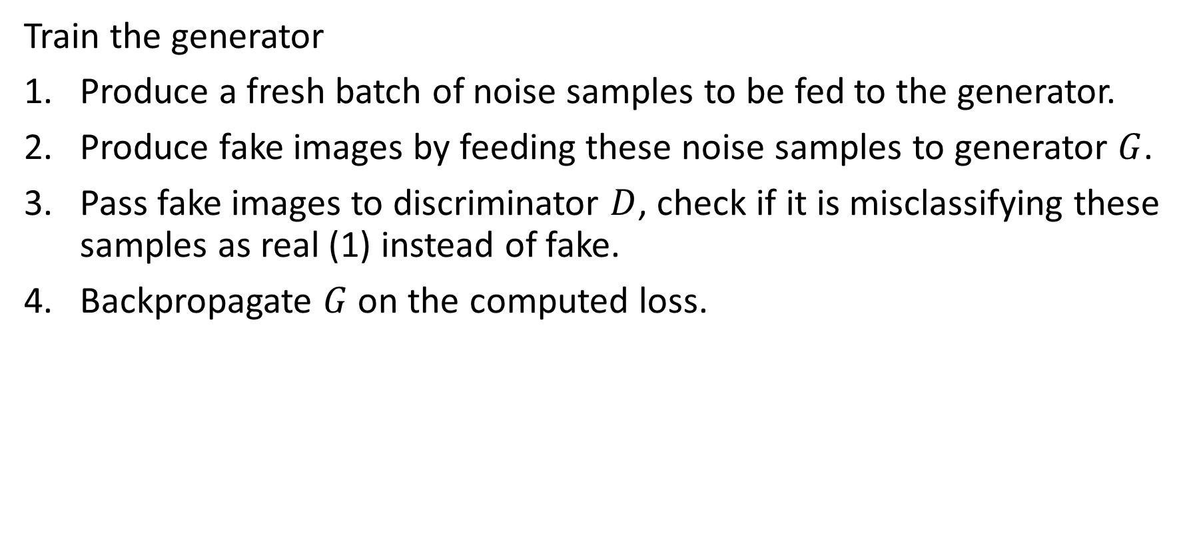
GAN implementation: trainer
Train the generator
Produce a fresh batch of noise samples to be fed to the generator.
Produce fake images by feeding these noise samples to generator $G$.
Pass fake images to discriminator $D$, check if it is misclassifying these samples as real (1) instead of fake.
Backpropagate $G$ on the computed loss.

Slide 26
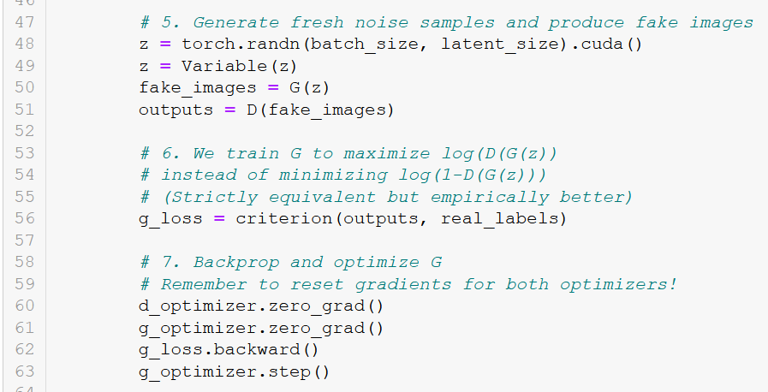
GAN implementation: trainer

Slide 27
GAN implementation: trainer
Definition (interleaved training):
In general, we like to train a discriminator, while the generator is fixed, and vice-versa. We then alternate a few rounds of training on the discriminator/generator.
This prevents the discriminator from getting used to what the generator is producing and in turn, forces the generator to generate better samples, with higher chance of fooling the discriminator.
This is called an interleaved training, and is very common in GANs, or game theory with multiple players trying to figure out their best strategies.
However, this does not ensure that the GAN training will converge!

Slide 28
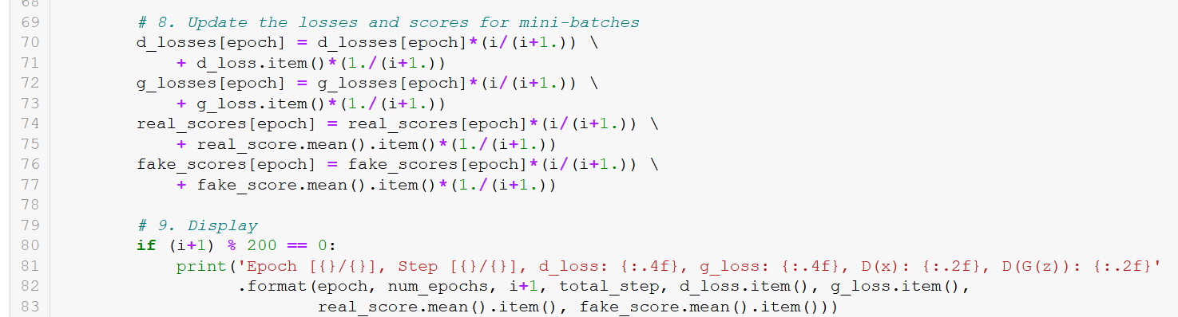
GAN implementation: trainer
Update loss and accuracy history after each mini-batch.
Display on periodic epoch values for convenience.

Slide 29

Many variations to this vanilla GAN exist!
In this lecture
More advanced concepts on GANs
Wasserstein distance in the GAN loss function
Conditional GANs
Progressive GANs
StyleGANs
CycleGANs
Deepfakes and ethics

Slide 30
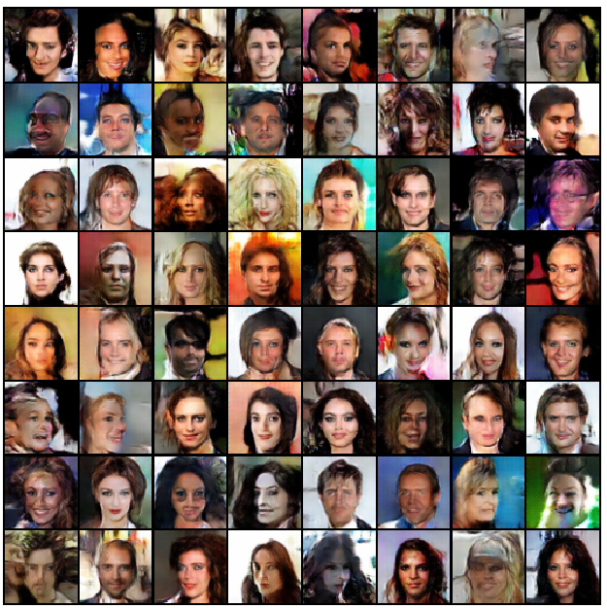
Limits of vanilla/Wasserstein GANs
Issue #1: GANs are effective at generating images, but
they are limited to small images sizes,
because of model stability,
and training required.
Generating high-resolution images is challenging for GANs, because the generator must learn how to produce both large structure and fine details at the same time.

Slide 31
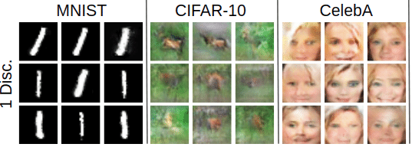
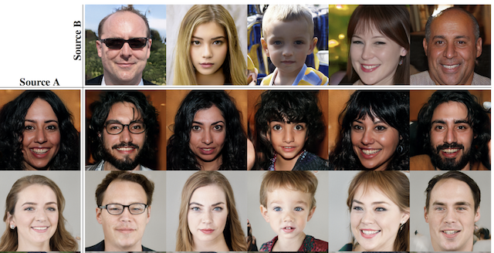
Limits of vanilla/Wasserstein GANs
Issue #2: Lack of control on the generators outputs
Limited understanding of the impact of noise vectors used as input in generators (amount of randomness? structure of the latent space?)
How to disentangle features/properties in images and add controls for these properties to the generator model?

Slide 32
Conditional GANs
Issue #2: Lack of control on the generators outputs.
Core idea of Conditional GANs [CondGAN]: Add some deterministic values to the noise samples used in the generator.
This deterministic value corresponds to the class you expect the sample to have (e.g. generate a handwritten 7).
Generator task is to fool the discriminator/critic by generating a sample, which will be classified as a “real 7” and not anything else (“fake 7”, “real 6” are both considered failure cases).

Slide 33
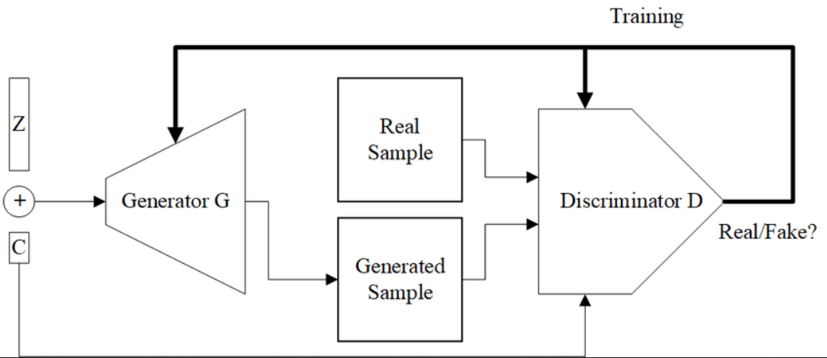
Conditional GANs
Core idea of Conditional GANs [CondGAN]: Add some deterministic values to the noise samples used in the generator.
This deterministic value corresponds to the class you expect the sample to have (e.g. generate a handwritten 7).
Generator task is to fool the discriminator/critic by generating a sample, which will be classified as a “real 7” and not anything else (“fake 7”, “real 6” are both considered failure cases).

Slide 34
CycleGAN
Core idea of CycleGANs [CycleGAN]: do not use noise as input for generator, use another image that you wish to transform!
Train an autoencoder style of architecture, with two generators.
One generator $G_{1}$ that transforms images of zebras into horses, and one generator $G_{2}$that transforms images of horses into zebras.
Train both generators to accomplish $G_{1}$($G_{2}$(x)) = x.
By doing so, you get a generator, which transforms images of a certain type into images of another type!

Slide 35
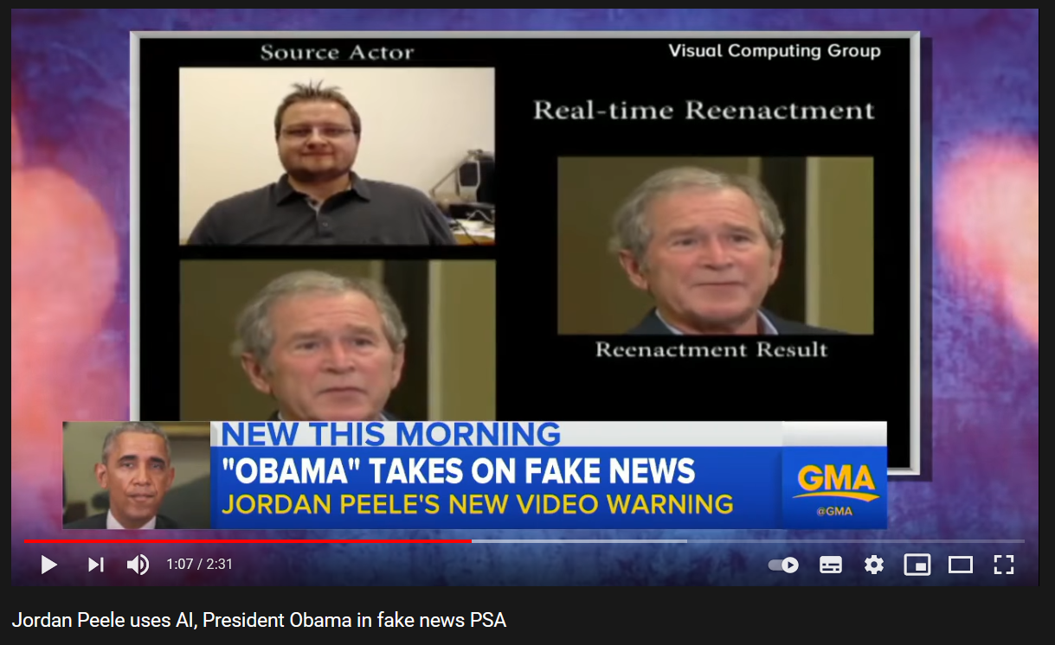
GANs and ethics
https://www.youtube.com/watch?v=bE1KWpoX9Hk

Slide 36
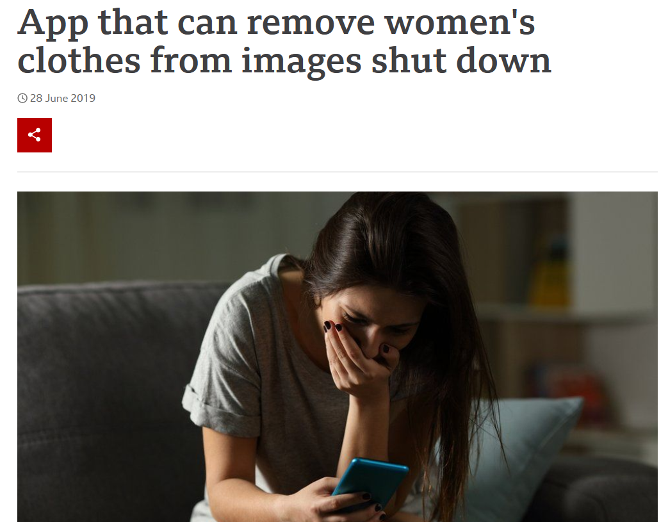
GANs and ethics
https://www.youtube.com/watch?v=bE1KWpoX9Hk
https://www.bbc.com/news/technology-48799045

Slide 37
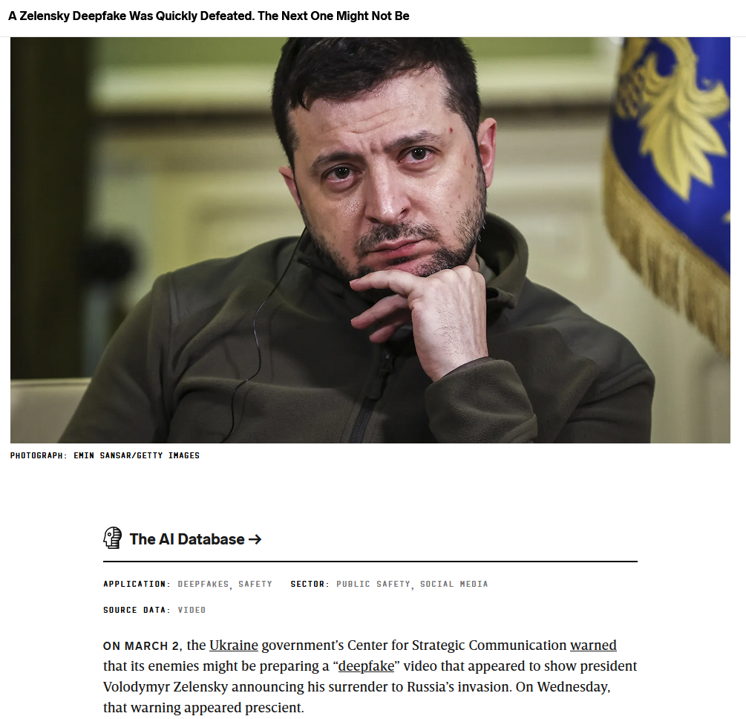
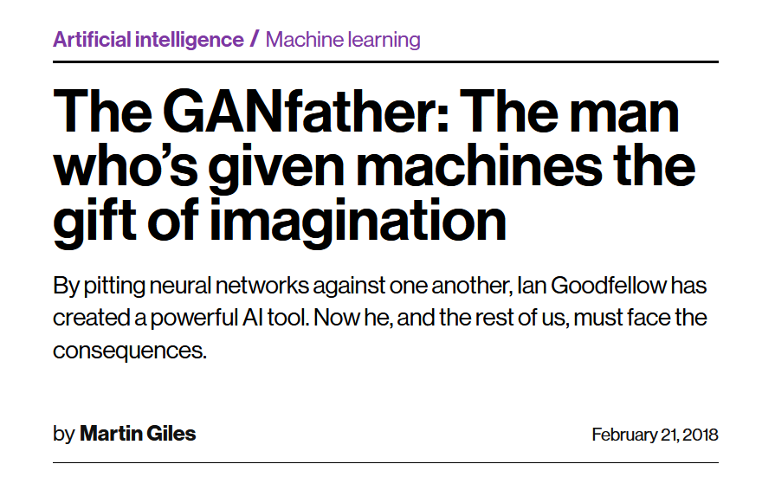
GANs and ethics
https://www.technologyreview.com/2018/02/21/145289/the-ganfather-the-man-whos-given-machines-the-gift-of-imagination/

Slide 38
GANs and ethics
https://www.technologyreview.com/2018/02/21/145289/the-ganfather-the-man-whos-given-machines-the-gift-of-imagination/

Slide 39
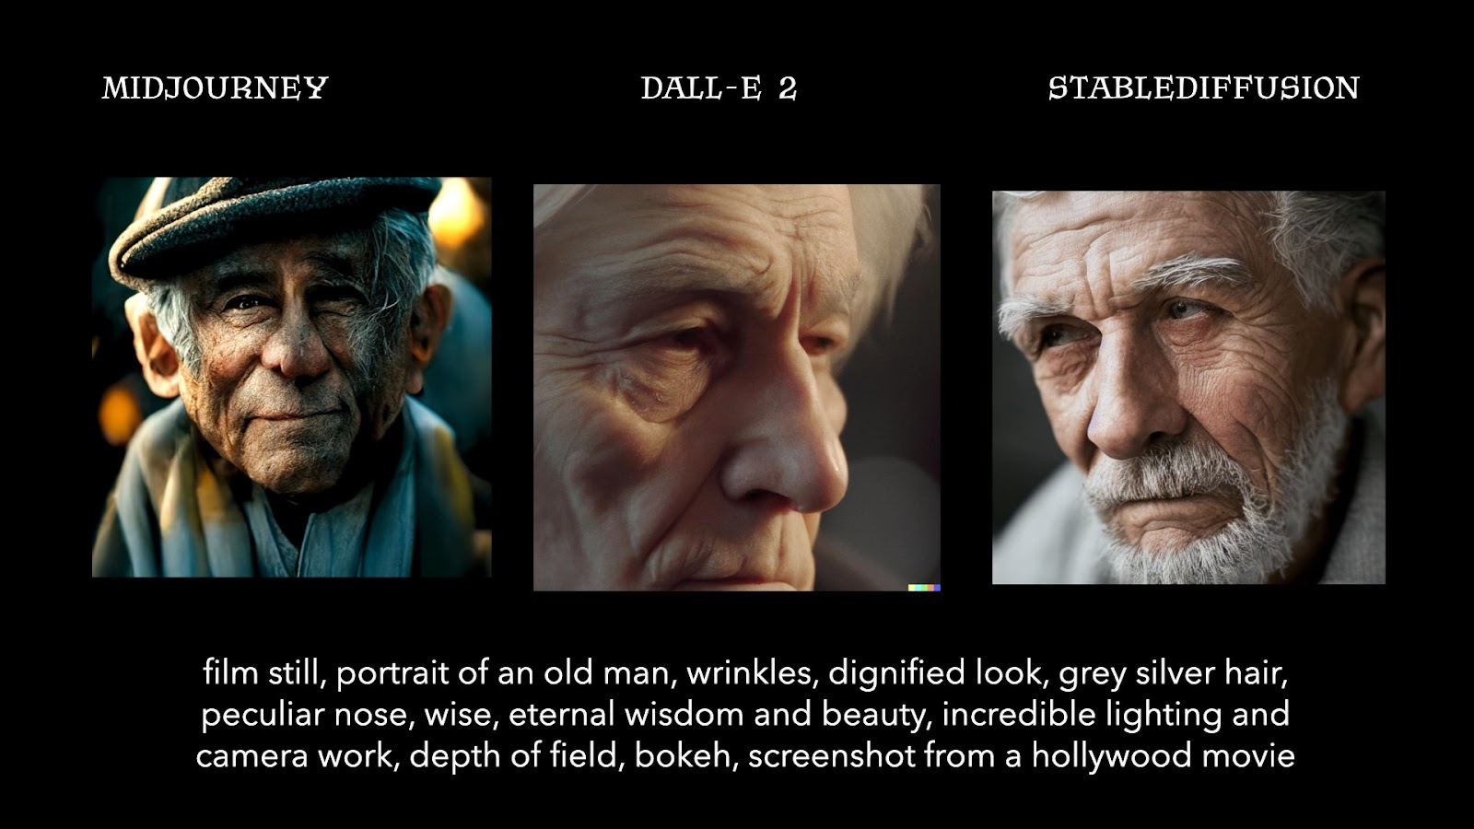
What about diffusion models?!
You might have heard diffusion models…
E.g. Dall-E2, StableDiffusion, MidJourney, etc.
Turns out: special type of generative models!

Slide 40
Diffusion Models: a definition
Definition (Diffusion Models):
Diffusion models are a class of stochastic mathematical models that have typically been used to describe the random motion of particles, often referred to as “Brownian motion.“
They are widely used in various fields, such as physics, chemistry, biology, and finance, for instance to model the stochastic behaviour of particles or other quantities that exhibit random fluctuations over time.
The fundamental concept behind diffusion models is the idea of Stochastic Differential Equations (SDEs).

Slide 41
A first task, denoising images
Let us start by defining the four components of our ML problem.
Task: take images from MNIST and noise them. The model should try its best to denoise them an get back to the original image.
Dataset: MNIST images, noised (inputs) and original (output).
Model: an encoder-decoder model of some sort, similar to an autoencoder (almost).
Loss and training procedure: As in the case of autoencoders, a simple MSE loss and a basic training procedure with Adam optimizer will do.

Slide 42
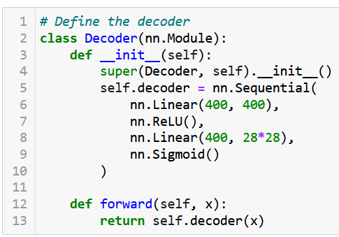
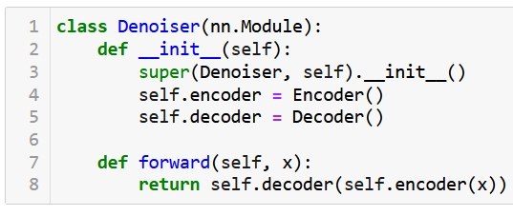
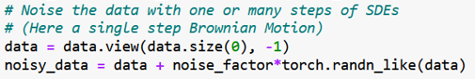
A first task, denoising images
For simplicity, we consider an encoder-decoder model, running on a simple noising operation and a denoiser consisting of simple linear layers.
And a basic training procedure…

Slide 43
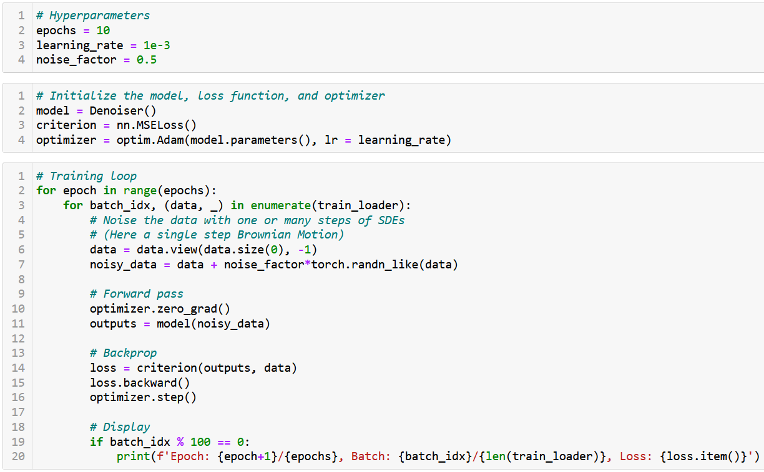

Slide 44
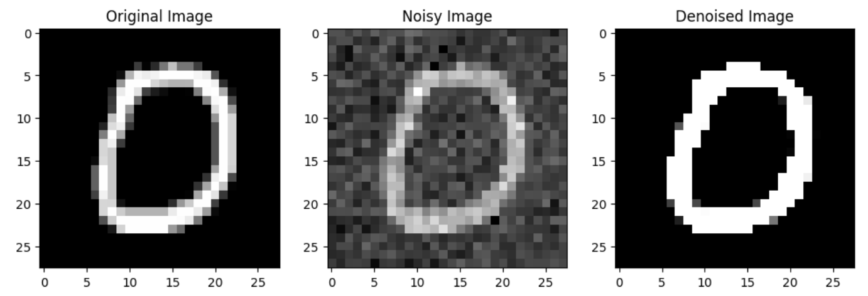
A first task, denoising images
The model trains and seems able to denoise lightly noised images.

Slide 45
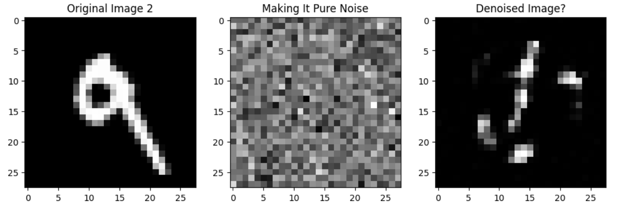
A first task, denoising images
The model trains and seems able to denoise lightly noised images.
Could it denoise a pure noise image, though? Not really.

Slide 46
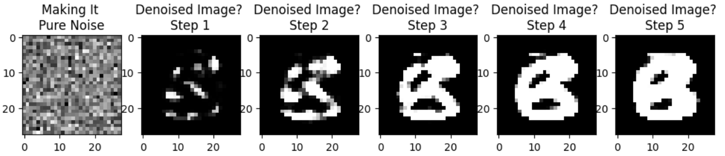
A first task, denoising images
The model trains and seems able to denoise lightly noised images.
Could it denoise a pure noise image, though? Not really.
What if we used the model many (e.g. 5) times in a row on our full noise image? Eventually would obtain something B&W in the likes of MNIST but somehow non-sensical in terms of shapes…?!

Slide 47
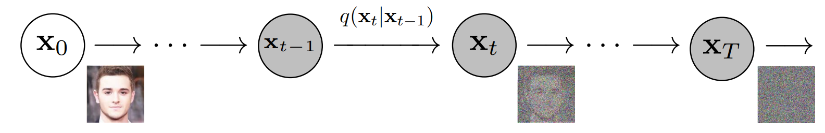
A (not so?) crazy idea
Idea: what if instead of noising the image in one step, and denoising it in one call of the model, we try iterative noising and denoising?
(Somehow similar to the idea of modifying the image iteratively during the iterated versions of our attacks in W5!)

Slide 48
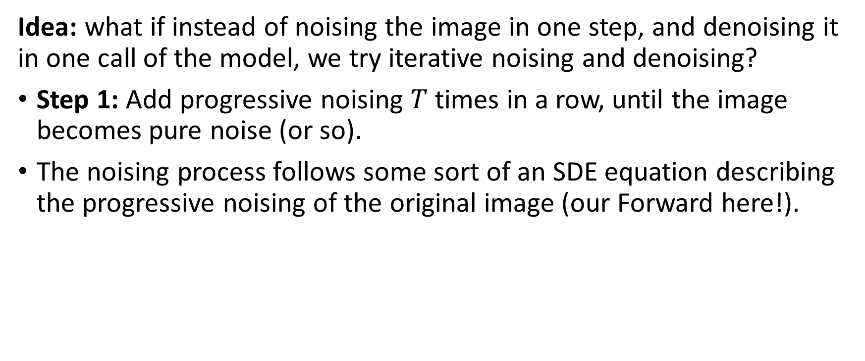
A (not so?) crazy idea
Idea: what if instead of noising the image in one step, and denoising it in one call of the model, we try iterative noising and denoising?
Step 1: Add progressive noising $T$ times in a row, until the image becomes pure noise (or so).
The noising process follows some sort of an SDE equation describing the progressive noising of the original image (our Forward here!).

Slide 49
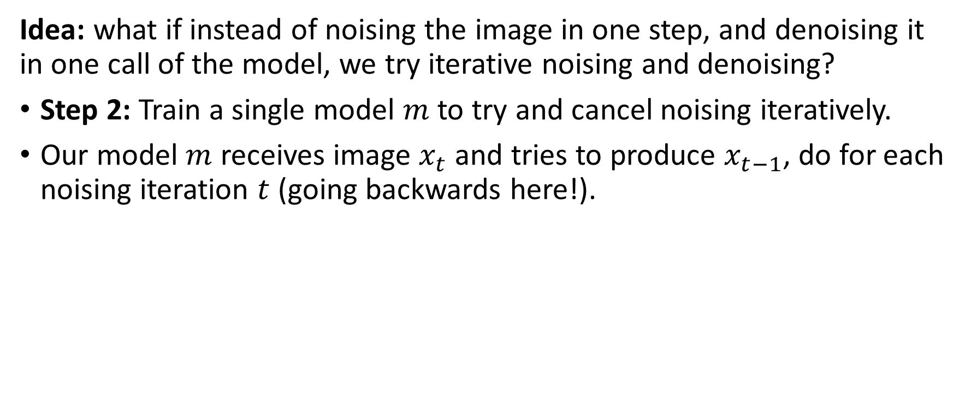
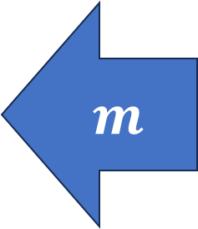
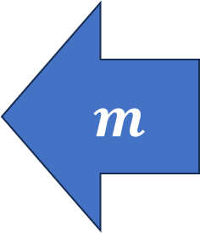

A (not so?) crazy idea
Idea: what if instead of noising the image in one step, and denoising it in one call of the model, we try iterative noising and denoising?
Step 2: Train a single model $m$ to try and cancel noising iteratively.
Our model $m$ receives image $x_{t}$ and tries to produce $x_{t−1}$, do for each noising iteration $t$ (going backwards here!).
$$m$$
$$m$$
$$m$$

Slide 50
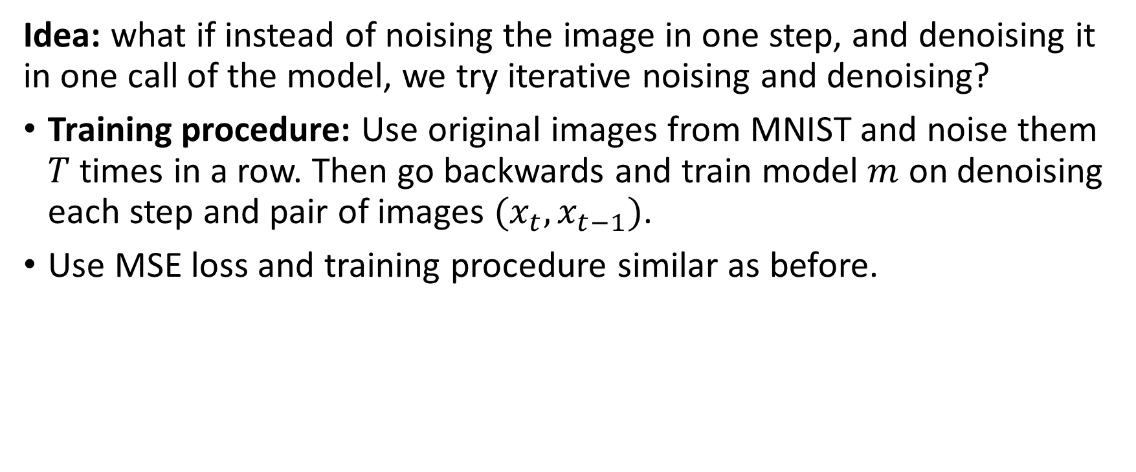
A (not so?) crazy idea
Idea: what if instead of noising the image in one step, and denoising it in one call of the model, we try iterative noising and denoising?
Training procedure: Use original images from MNIST and noise them $T$ times in a row. Then go backwards and train model $m$ on denoising each step and pair of images $(x_{t}, x_{t−1})$.
Use MSE loss and training procedure similar as before.

Slide 51
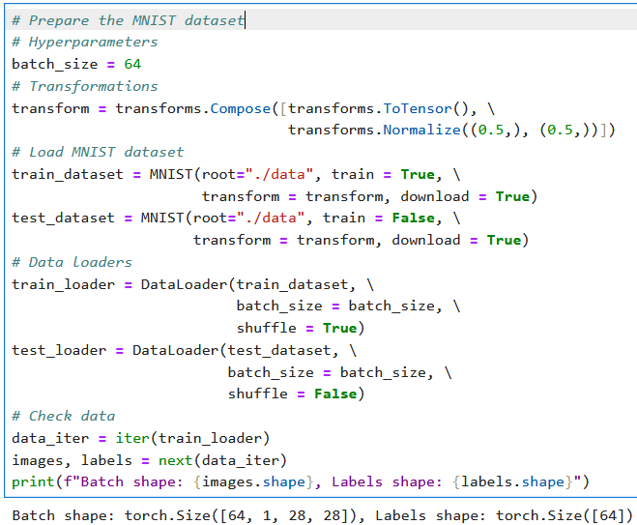
A basic Diffusion Model setup
First, we need a toy dataset.
For simplicity, we will rely on MNIST and will attempt to train a model that can generate MNIST-like images from noise.
As in previous lectures, we will prepare our dataset and dataloader objects.
Nothing particularly difficult or exciting here.

Slide 52
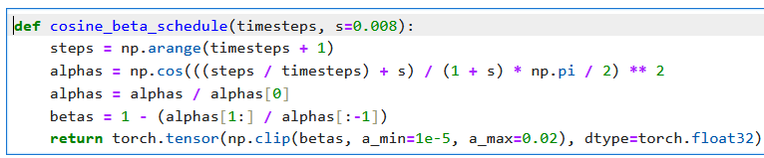
A basic Diffusion Model setup
Next, we need a noising function, whose job is to progressively add noise to MNIST images
Define a noise scheduler, have it progressively add more noise.
Cosine beta scheduler: on early timesteps, add little noise, on late timesteps, add more noise, smooth transition.

Slide 53
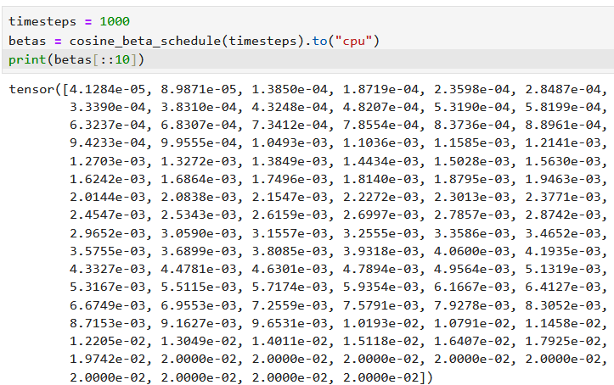
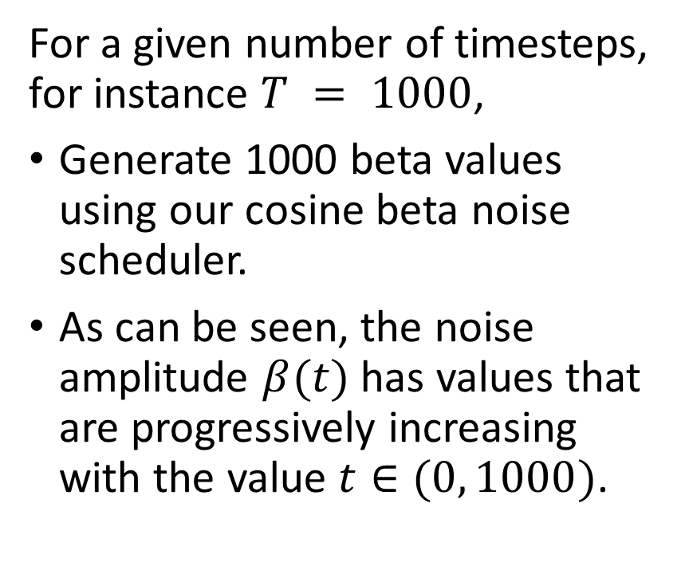
A basic Diffusion Model setup
For a given number of timesteps, for instance $T = 1000$,
Generate 1000 beta values using our cosine beta noise scheduler.
As can be seen, the noise amplitude $β(t)$ has values that are progressively increasing with the value $t∈(0, 1000)$.

Slide 54

A basic Diffusion Model setup
Finally, define a forward diffusion function, whose objective is to progressively noise the MNIST images.
Apply noise using the noise amplitude $β(t)$ on each time step $t∈(0, 1000)$. Return all progressively noised images and noises applied.
More specifically, we have
$$x_{t}=\sqrt{α_{t}}x_{t−1}+\sqrt{1−α_{t}} ε$$
Where $ε$is a Gaussian noise, with mean zero and variance one, to be added to the image. And $α_{t}$ is defined as
$$α_{t}= \prod_{i=0}^{t}{(1 −β_{i})}$$

Slide 55


A basic Diffusion Model setup
Finally, define a forward diffusion function, whose objective is to progressively noise the MNIST images.
Apply noise using the noise amplitude $β(t)$ on each time step $t∈(0, 1000)$. Return all progressively noised images and noises applied.

Slide 56

Try it on a single MNIST image!

Slide 57

Try it on a single MNIST image!

Slide 58

A quick word about our UNet model
For the task of denoising a noised image, we will use a UNet model.
Definition (UNet models):
A UNet is a special type of convolutional neural network (CNN) designed for image-to-image tasks, such as image segmentation, denoising, or super-resolution.
Figure: A visual representation of a UNet model.

Slide 59
A quick word about our UNet model
For the task of denoising a noised image, we will use a UNet model.
Definition (UNet models):
A UNet is a special type of convolutional neural network (CNN) designed for image-to-image tasks, such as image segmentation, denoising, or super-resolution.
Known for their U-shaped architecture, which consists of:
Encoder (Downsampling Path): Compresses the input image into a smaller representation.
Bottleneck (Middle Section): Captures high-level features.
Decoder (Upsampling Path): Reconstructs the image back to its original size while combining detailed features from the encoder.

Slide 60

Implementing a UNet
Start by designing a residual block (works as in W4).
Magic happens in the final forward operation (x + skip).

Slide 61

Implementing a UNet
Then, implement the three stage UNet model.

Slide 62
Implementing a UNet
Then, implement the three stage UNet model.

Slide 63
Predicting noise and denoising
Important: The purpose of the UNet model is to predict the noise added to the image, not to denoise the image directly!
Predicting the denoised image​ directly can lead to unstable training, especially when the image is heavily noised (​i.e. at high timesteps).
Noise prediction is more reliable because noise is sampled from a known Gaussian distribution, making it easier for the model to learn.
Predicting the denoised image​ directly would require the model to understand the noise distribution and the underlying image structure at once. By focusing only on the noise, the model simplifies its task.
Using the predicted noise, we calculate a "less noisy" version of the image, which is roughly equivalent.

Slide 64

Predicting noise and denoising
Let us then define a denoising function that uses the model and progressively denoises the image using the model predictions.

Slide 65

Predicting noise and denoising
At the moment, the model has not been trained, so denoising does not work well (which is expected).

Slide 66
Training the model
After initializing everything, train the model by
Noising an image drawn from MNIST over the timesteps (forward diffusion) and keep track of the noise values.
Have the model predict the noise added to each timestep.
Use MSE to compare the predicted noise and the “real” noise.
Backprop, rinse and repeat until convergence.
Using Adam and default learning rate values for simplicity.
Keep track of loss values for training curves.

Slide 67

Training the model
After initializing everything, train the model by
Noising an image drawn from MNIST over the timesteps (forward diffusion) and keep track of the noise values.
Have the model predict the noise added to each timestep.
Use MSE to compare the predicted noise and the “real” noise.
Backprop, rinse and repeat until convergence.
Using Adam and default learning rate values for simplicity.
Keep track of loss values for training curves.

Slide 68


It trains?
It seems to train, although it could benefit from our arsenal of training techniques (LR decay/scheduling, using validation, etc.)

Slide 69

Let us visualize the results!
After training, we obtain a model that is “capable” of denoising images.

Slide 70


In practice, however…
In practice, need more iterations and more steps of noising and denoising, in the thousands or so.
Our Notebook 3 demo runs on only $T =1000$ steps of noising/denoising and would probably work better with a larger $T$ value and smaller noising at each step…
And maybe a larger model…
It is expensive to train (!), but you get the idea…

Slide 71
In practice, however…
We were somewhat able to train a model to denoise and eventually obtain a convincing MNIST picture from something that was close to pure noise!
Another possible approach to generate images out of thin air?
Keep in mind: all advanced ideas from previous weeks are open! (using advanced layers, making it conditional like conditional GANs, cyclic, progressive, etc.)

Slide 72



In practice, however…
What happens if we use the reverse diffusion process and our model on an image that is pure noise? Do we obtain an MNIST-like sample?
Meh… Sometimes yes, sometimes no.

Slide 73
In practice, however…
Clearly, we are not there yet!
There is a need for more advanced practices to training diffusion models efficiently.
Learn more in the Computer Vision course on Term 7!
(Or if you already want a pre-trained implementation, readily available…) https://github.com/VSehwag/minimal-diffusion

Slide 74



Making it conditional
If you train with a dataset of captioned images, the extra label could be used during the denoising part, to help the denoising model figure out what was the original image about.
Encode these captions and use them during training of the denoising model in place of $t$.
Helps to direct the denoising in right direction!

Slide 75

Making it conditional
Label $\hat{z}$could be the class of the MNSIT image, or the embedding of a text caption.
During testing, use pure noise as $x_{N}$ and ask the user for a caption of their choice that will be compressed as $\hat{z}$.
Use your denoiser many times in a row and obtain an image matching the caption $\hat{z}$ starting from pure noise?!

Slide 76


Making it conditional
Label $\hat{z}$could be the class of the MNSIT image, or the embedding of a text caption.
During testing, use pure noise as $x_{N}$ and ask the user for a caption of their choice that will be compressed as $\hat{z}$.
Use your denoiser many times in a row and obtain an image matching the caption $\hat{z}$ starting from pure noise?!

Slide 77
Diffusion: a good entry point to continue your study of generative models
What is “stable” diffusion then? The "stable" part of stable diffusion comes from optimizations that make the model more efficient and stable, particularly for large-scale text-to-image generation tasks.
While it would be impossible to explain the issues and stable diffusion in two minutes, know that it achieves this using latent diffusion, a key innovation.
Normal Diffusion Models: Operate directly in pixel space, which can be computationally expensive and slow for high-resolution images.
Stable Diffusion: Operates in a latent space (a compressed representation of the image), significantly reducing computational costs and making the process faster and more efficient.

Slide 78
Diffusion: a good entry point to continue your study of generative models
Something for later in a more advanced Computer Vision course?
What is “stable” diffusion then? The "stable" part of stable diffusion comes from optimizations that make the model more efficient and stable, particularly for large-scale text-to-image generation tasks.
While it would be impossible to explain the issues and stable diffusion in two minutes, know that it achieves this using latent diffusion, a key innovation.
Normal Diffusion Models: Operate directly in pixel space, which can be computationally expensive and slow for high-resolution images.
Stable Diffusion: Operates in a latent space (a compressed representation of the image), significantly reducing computational costs and making the process faster and more efficient.

Slide 79

Diffusion: a good entry point to continue your study of generative models
If you want online resources, I would warmly recommend this course from Jeremy Howard (Fast.ai), one of the most important AI teachers out there, is probably very nice to take…
https://www.fast.ai/posts/part2-2023.html

